Slide 1

Http Protocol
by Alex Joslin

Slide 2
What is HTTP?
Hyper Text Transfer Protocol
Communication between web servers & clients
Example of HTTP in action:
Loading web pages
Submitting an online form
Ajax calls
API calls

Slide 3
What is HTTPS?
Hyper Text Transfer Protocol Secure
HTTPS is a protocol that is basically the same as HTTP
but more secure.
Data is encrypted through SSL
Always use HTTPS when your website deals with
credit card information and other sensitive data.

Slide 4
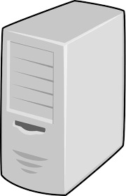

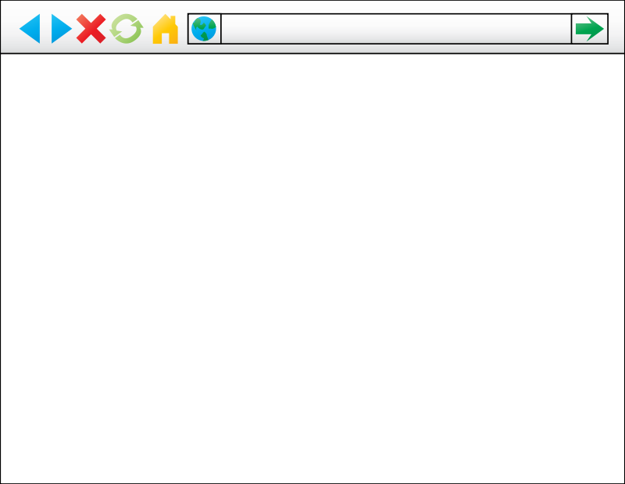


How does HTTP work?
Client
(Web Browser)
Request
Server
Response
Listening on
port 80

Slide 5

Minecraft example of clients and servers

Slide 6
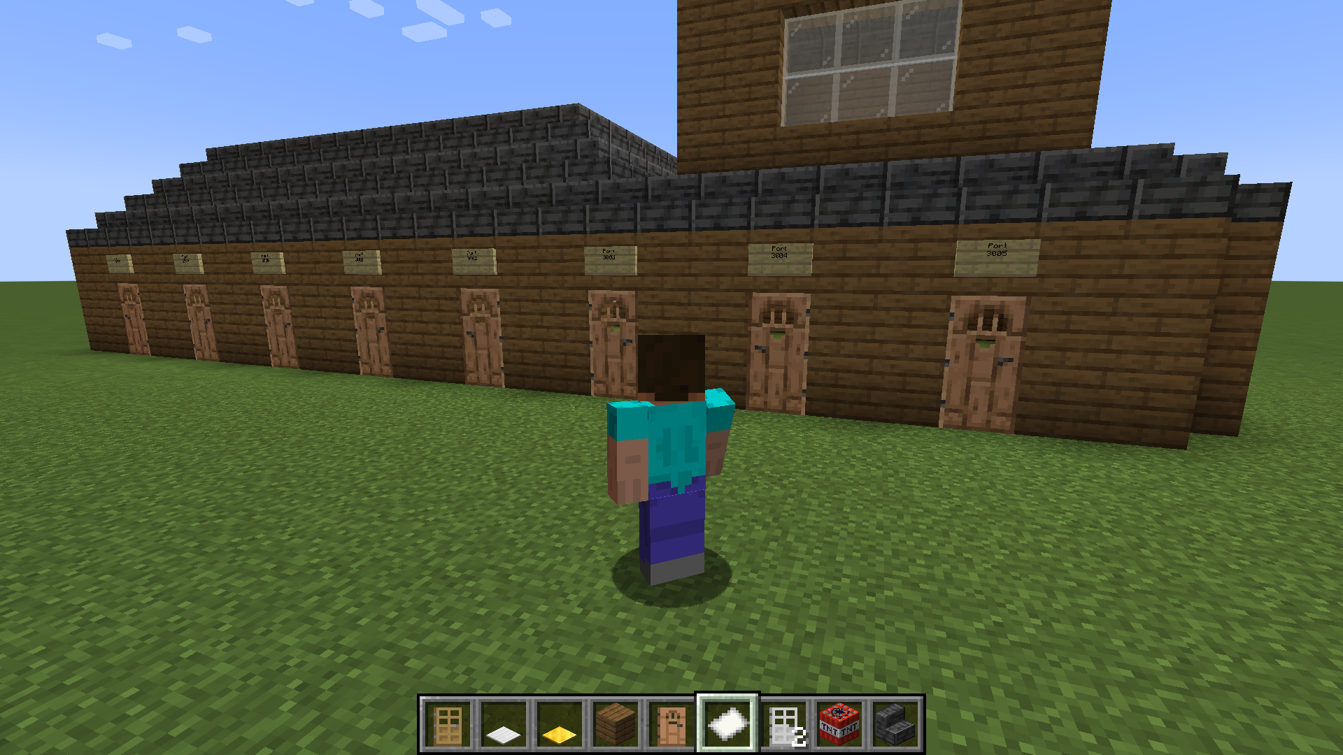

Computer
Server
Ports
Client

Slide 7
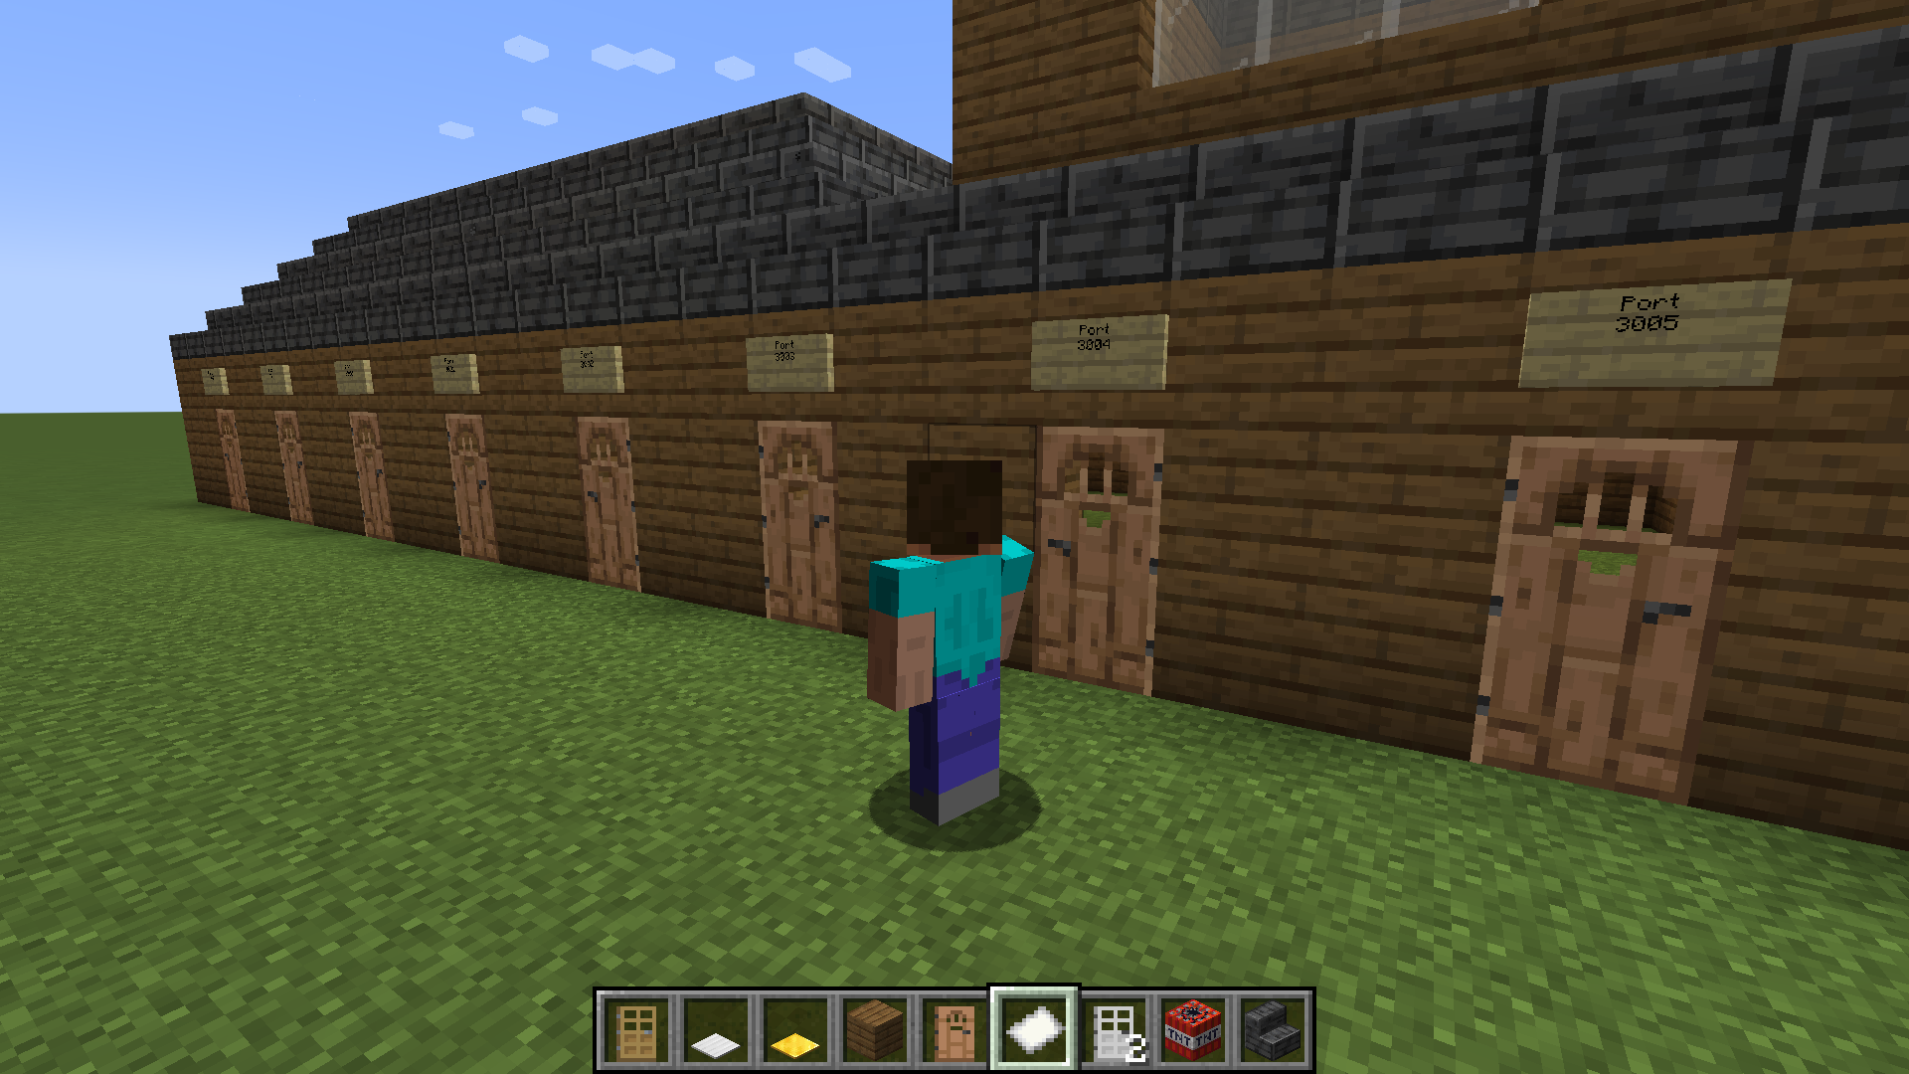

Slide 8
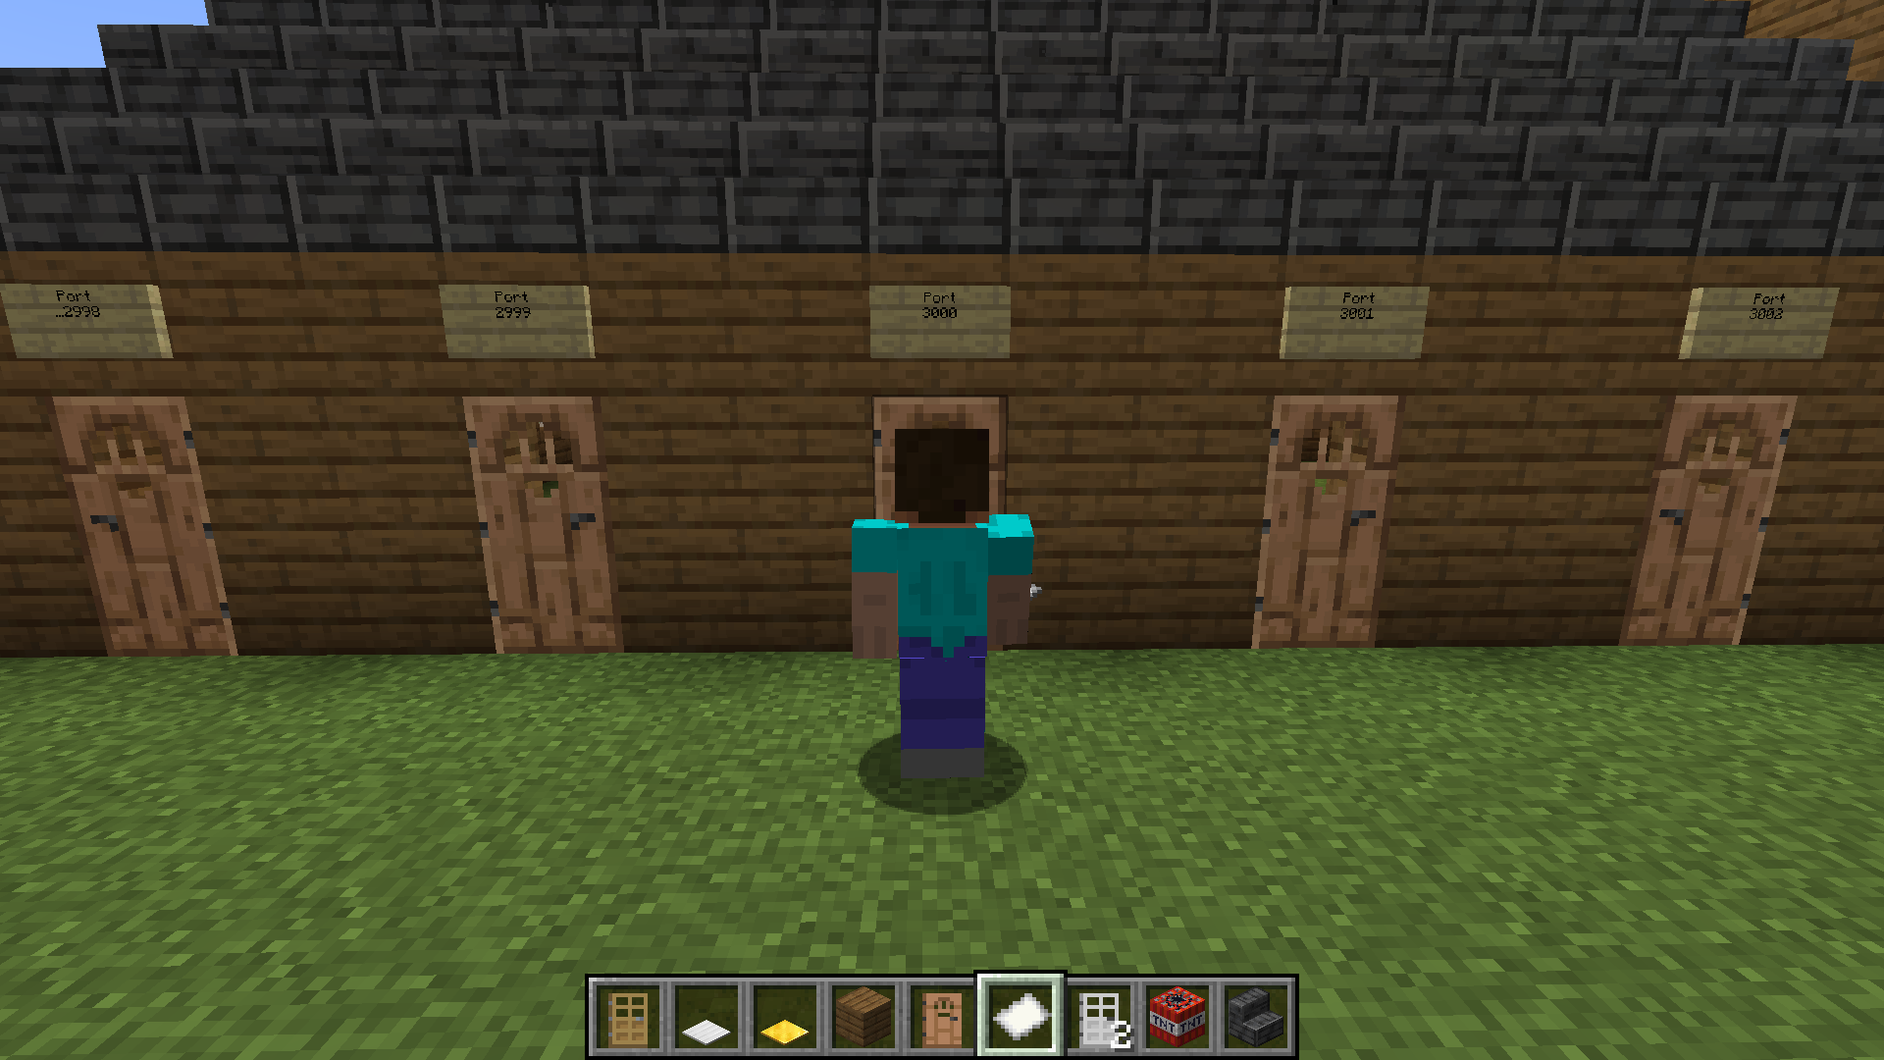

Slide 9
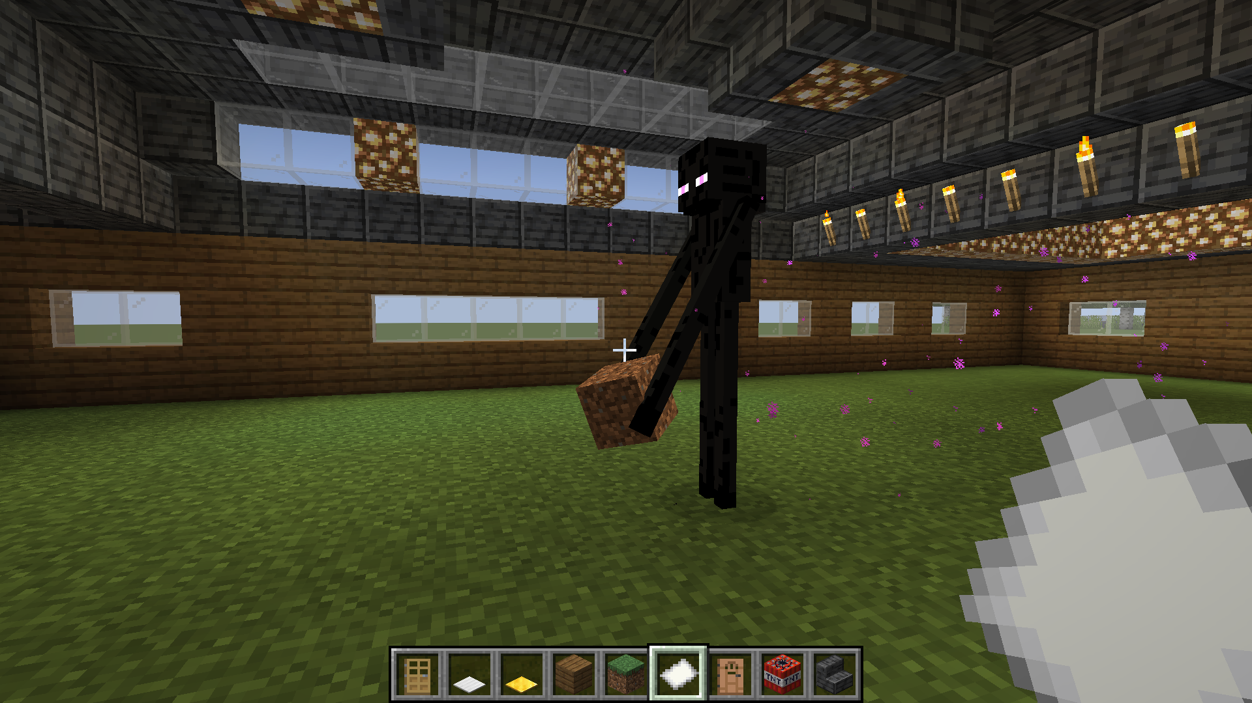
Server
Response
Request

Slide 10
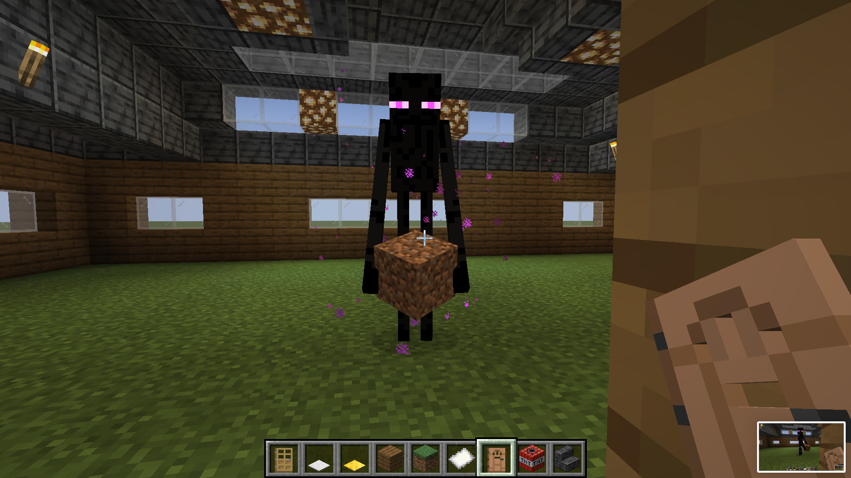
Server
Response

Slide 11


How does HTTP work?
Client
(Web Browser)
Request
Server
Response
Listening on
port 80

Slide 12
How does HTTP work?
Examples:
get html page
send a form info
update data in database
delete data in database
GET:
POST:
PUT:
DELETE:
Client
(Web Browser)
Request
Server
Response
Listening on
port 80

Slide 13




How does HTTP work?
Examples:
get html page
send a form info
update data in database
delete data in database
GET:
POST:
PUT:
DELETE:
Client
(Web Browser)
Request
Server
Response
Listening on
port 80
Plain Text

Slide 14
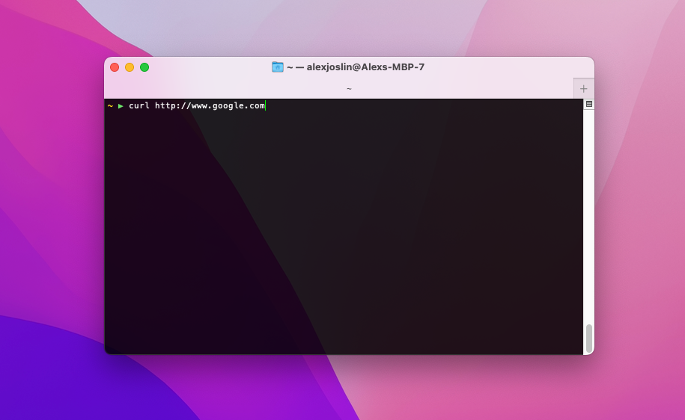

How does HTTP work?
Examples:
get html page
send a form info
update data in database
delete data in database
GET:
POST:
PUT:
DELETE:
Client
(Web Browser)
Request
Server
Response
Listening on
port 80
(Terminal)
Plain Text

